Slide 1

Alpine: New User Seminar

Slide 2

Alpine: New User Seminar
Instructors: Brandon Reyes, Andy Monaghan
Website: www.rc.colorado.edu
Documentation: https://curc.readthedocs.io
Helpdesk: rc-help@colorado.edu
Slides: https://github.com/ResearchComputing/rmacc_2024
In the directory “alpine_new_user_seminar”

Slide 3

RMACC Cyber Infrastructure Portal
https://ask.cyberinfrastructure.org/c/rmacc/65
This forum provides opportunity for RMACC members to converse amongst themselves and with the larger, global research computing community.
The “go to” general Q&A platform for the global research computing community - researchers, facilitators, research software engineers, CI engineers, sys admins and others.
Notes:
Stack exchange but for RC specifically

Slide 4
What is CURC?
CU Research Computing (CURC) is a group at CU Boulder that hosts a variety of resources. One of these resources is the Alpine High-Performance Computing (HPC) system. All individuals within the RMACC community can request an account with CURC, which will allow them to freely run on Alpine. Access to Alpine for the RMACC community is facilitated through Open OnDemand.

Slide 5
Learning Goals
Understand basic CURC resources & the Alpine cluster
Getting an account & logging in
Navigate the RC system
Running a job
Help!

Slide 6

Things to take note of:
Confusing, ambiguous, highly nuanced concepts
Our goal is to help you avoid common mistakes, pitfalls, and frustrations
Ask Questions!

Slide 7


CURC Resources Include:
High Performance Computing (HPC)
Storage of Research Data
High-Speed Data Transfer
Data Sharing
Cloud Computing
Training and Education
Secure Research
Notes:
Can advise on Secure Research, have a CMMC environment (Preserve) available (let know available if doing DoD or DoE things)

Slide 8

Primarily known for:
High Performance Computing (HPC)

Slide 9

High Performance Computing (HPC)
vs. Traditional Computing
Traditional computing generally has access to a single processor (perhaps multiple cores)

Slide 10
What can I use HPC for?
Tiny Job
BIG Job
Results
Tiny Job
Results
Tiny Job
Code-Internal Parallelization
Code-External Parallelization
Example: Climate model
Example: Lots of satellite images

Slide 11
What can I use HPC for?
Solving large problems that require more:
Memory than you have on your PC
cores/nodes/power thank you have on your PC
Jobs that require hardware you may not have:
High Performance GPU computing
Specific Operating System
Visualization rendering

Slide 12
Research Computing Resources

Slide 13
HPC Cluster: Alpine
Alpine is the 3rd-generation HPC cluster at CURC, following:
Janus
RMACC Summit
Alpine is a heterogeneous cluster with hardware currently provided by CU Boulder, CSU, and Anschutz
Access available to CU Boulder, CSU, AMC and RMACC users
Alpine

Slide 14
HPC Cluster: Alpine
Hardware on Alpine will continue to be purchased and released in stages:
Alpine (stage 4):
347 General CPU Nodes
AMD Milan, 64 Core, 3.74G RAM/Core
12 NVIDIA GPU Nodes
3x NVIDIA A100 (atop General CPU node)
8 AMD GPU Nodes
3x AMD MI100 (atop General CPU node)
22 AMD High-Memory Nodes
AMD Milan, 48 Core, 21.5G RAM/Core
Additional Hardware contributed by CSU, AMC
Nodes which boost priority for CSU/AMC users
Alpine
Notes:
AMC – must sign end user agreement

Slide 15
HPC Cluster: Alpine
Interconnect
CPU nodes: HDR-100 InfiniBand (200Gb inter-node fabric)
GPU nodes: 2x25 Gb Ethernet +RoCE
Scratch Storage: 25Gb Ethernet +RoCE
Operating System
RedHat Enterprise Linux version 8 operating system
Alpine

Slide 16
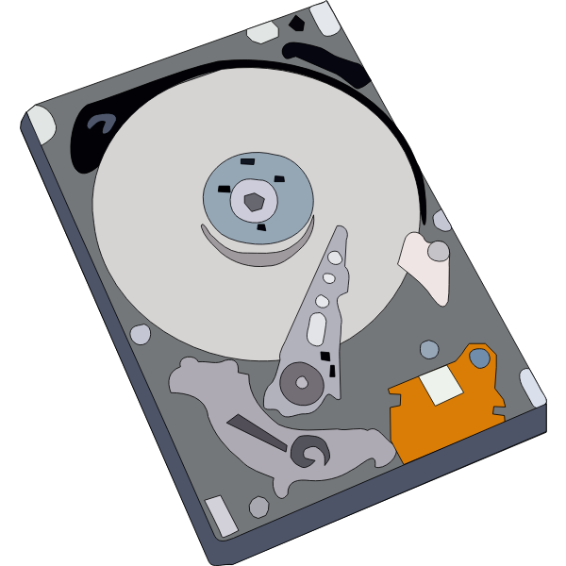

Storage at CURC
PetaLibrary
Local or Cloud
Core
Included with RC account
/home
/projects
scratch space
You can download your data locally or to a variety of other cloud resources
Cloud Foundations at Research Computing
Paid Service for:
Storage
Archive
Sharing of research data
Notes:
CU Research Computing hosts a free-to-use on-premise cloud service, called CUmulus, which supports cases not well-suited for HPC such as webservers, databases, and long-running services. The CUmulus service includes access to a Virtual Private Cloud (VPC) which provides users with a logically isolated section of the cloud with a small number of outside routable floating IP addresses. Within this VPC customers will be given an allocation of:
CPU cores
Memory
Storage

Slide 17
Data Sharing: Within RC
Sharing workspaces
Project space
Scratch Space
PetaLibrary Space*
*If you have purchased PetaLibrary space; RMACC members may purchase PetaLibrary active space at an external user rate (institutional agreement required).
Notes:
Highlight not sharing home space
Where configs are at, people can mess with them

Slide 18
Data Sharing: Outside RC
Globus (recommended):
GUI Web Application
Automates large transfers
Resumes failed transfers
Distributes large transfers across data transfer nodes (DTNs)
Endpoints that can shared
Command line tools
scp, sftp, rsync, rclone
Note: not available to all RMACC members

Slide 19

Cloud Computing
CURC supports AWS, Azure, and GCP
For use cases not well-supported by HPC
Note: RMACC users are not eligible for CURC’s commercial cloud support ( use Jetstream2!)
Can be used as an alternative to HPC
Can be used to enhance HPC
Automatic job submission, high availability, etc.
Notes:
Cloudbursting

Slide 20
Accessing Research Computing

Slide 21
How to Access RC Resources?
Get an RC account
Set up two-factor authentication with Duo
(Inform us of any specific needs)
Log in
Create greatness! (responsibly)

Slide 22
Getting an RC Account (1)
University of Colorado, Boulder users and CU Boulder affiliates:
Request an account through the RC Account request portal
https://rcamp.rc.colorado.edu/accounts/account-request/create/organization
Colorado State University users:
Request an CSU eID if you don’t have one
Fill out account application form
Duo authentication
https://it.colostate.edu/research-computing-and-cyberinfrastructure/compute/get-started-with-alpine/
If you do not have an account yet, we would be happy to assist after this lecture if time allows!

Slide 23
Getting an RC Account (2)
CU Anschutz Users:
Create an ACCESS-CI Account in the ACCESS user portal
Reach out to hpcsupport@cuanschutz.edu to receive and sign the End-User Agreement
RMACC Users:
Create an ACCESS-CI Account in the ACCESS user portal
Email us at rc-help@colorado.edu and request an account. Please include the following information: your ACCESS username, your institutional affiliation, your role, your department, your first and last name, your preferred email address for communication
If you do not have an account yet, we would be happy to assist after this lecture if time allows!

Slide 24
Demo: Getting an Account
CU Boulder, CSU users and affiliates:
Request an account through the RC Account request portal:
https://rcamp.rc.colorado.edu/accounts/account-request/create/organization
AMC, RMACC users and affiliates:
Request an account through the ACCESS-CI User Registration Portal:
https://identity.access-ci.org/new-user.html

Slide 25
Your RC Account
Access to:
Alpine Cluster
Core Storage
PetaLibrary Storage*
Open OnDemand
Approximately 2,000 Service Units (SUs) per month
*If purchased
Notes:
https://ondemand.rc.colorado.edu/
https://ondemand-rmacc.rc.colorado.edu/

Slide 26
Your RC Account
How can I use more computational time?:
Trailhead Allocation (Default for all users)
~2,000 SUs / Month
Ascent Allocation
350,000 SUs. (100,000 SUs for RMACC members; variable for AMC, CSU)
Peak Allocation
>350,000 SUs (not available to RMACC members; variable for AMC, CSU)
Request an allocation at https://curc.readthedocs.io/en/latest/clusters/alpine/allocations.html

Slide 27
Two Factor Authentication (Duo)
Provides an extra level of authentication
We are outside the firewall!
Valuable resources
Inviting, high-profile target
Duo
You will receive information on setting up Duo when your account is established.
The Duo instance you use depends on your institutional affiliation.

Slide 28
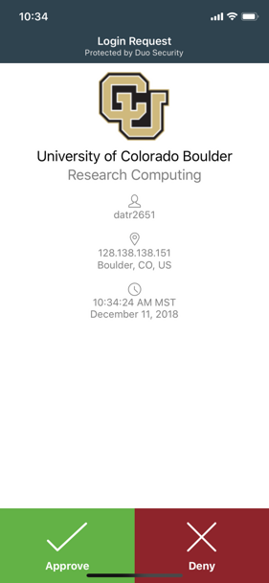
Duo Authentication
Duo smartphone app (recommended)
Phone Call/Text is an alternatives

Slide 29
Linux comfort level check
On a scale from (1-10) how familiar/comfortable are you with Linux?
The command line
Basic commands
Linux filesystem
Navigating the filesystem

Slide 30
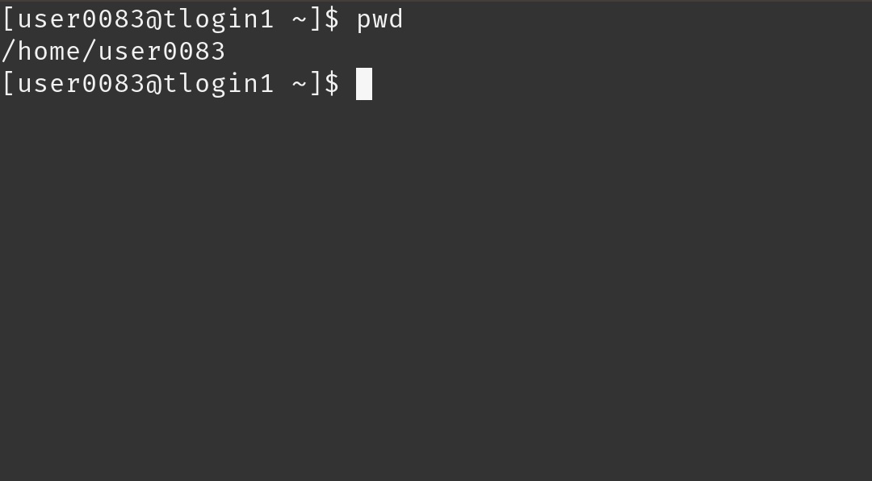
Terminal
Mac or Linux
Terminal application
Windows
PuTTY
Powershell
Open OnDemand
For CU Boulder users: ondemand.rc.colorado.edu/
For AMC, CSU and RMACC users: ondemand-rmacc.rc.colorado.edu/

Slide 31
Demo: Logging in via Terminal*
To login to an RC login node (CU or CSU users):
$ ssh <username>@login.rc.colorado.edu
To login to an RC login node (AMC users):
$ ssh <username>@login-ci.rc.colorado.edu
Supply your IdentiKey password and your Duo app will alert you to confirm the login
*ssh-based login is not available to RMACC users at this time – use OnDemand!

Slide 32
Demo: logging in with OnDemand
CURC Open OnDemand is a browser based, integrated, single access point for all of your HPC resources at CU Research Computing.
CU Boulder: https://ondemand.rc.colorado.edu.
Other RMACC Institutions: https://ondemand-rmacc.rc.colorado.edu/

Slide 33
Logging In
It’s important to note that you are NOT logging into any specific resource, Alpine, Blanca, etc.
When you log in, you land on our login nodes
From there, you can access our other resources:
Alpine
Blanca
Petalibrary

Slide 34
Navigating Research Computing

Slide 35
Node | File System
One computing server Physical hardware Work together in parallel | The basic tree-like layout From most nodes* you have access to most file systems
/
d1
d2
d3
d4
f1
f2

Slide 36
Node | File System
One computing server Physical hardware Work together in parallel | The basic tree-like layout From most nodes* you have access to most file systems
/
d1
d2
d3
d4
f1
f2

Slide 37
Node Types
Login | Compile | Compute
This is where you are when you login via a shell For editing code; job scheduling No heavy computation | This is where you compile code, install packages For exploring the Alpine software environment; editing compiling, and installing code; scheduling jobs No heavy computation | This is where scheduled jobs run For any type of research computation
Ex. edit job script | Ex. Install python libs | Ex. Running Matlab

Slide 38
Alpine Compile Nodes
Alpine’s acompile command starts an interactive job in which users can explore the compute environment and compile code.
Users can request specific resources (i.e. more cores to compile with)
Limits dedicated hardware set aside
Can’t accidentally run full workflows

Slide 39
Alpine Compile Nodes
$ acompile starts a job with default: 1 core, 3.74GB RAM, for 60 minutes*
$ acompile --help
--time=<time-limit> # set minimum runtime
--ntasks=<number-of-cores> # default 1, max 4
--gpu=<nvidia|amdgpu> # request gpu to compile with
--x11 # enable graphical forwarding

Slide 40
Demo: Exploring Nodes
Once logged in, type:
$ acompile
To log in to an Alpine compile (or head) node.
Once on a compile node, type:
$ module avail
To list currently available software

Slide 41
Filesystem Structure
/home (2GB) | /projects (250GB) | /scratch/alpine (10TB)
Scripts, Code, Small, important files/directories Not for sharing files or job output | Code/files/libraries Software you are installing Sharing files Not for job output | Output from running jobs Large files/datasets Sharing files Cluster specific Not for long term storage
Ex .bashrc | Ex. Shared job scripts | Ex. Data

Slide 42
Exploring the Filesystem
Once logged in use the following commands to navigate to your different workspaces
$ cd /home/<user>
$ cd /projects/<user>
$ cd /scratch/alpine/<user>

Slide 43
Using RC Resources
So far we have:
Logged in
Explored nodes
Explored filesystem
How do we actually use the computing resources?

Slide 44
Running a Job

Slide 45
Jobs
What is a “job”?
Work for the cluster to perform on
Has a unique ID
Batch jobs
Submit job script which will be executed when resources are available
Create script containing information about the job
Submit the job file to a queue
Interactive jobs
Work interactively at the command line of a compute node

Slide 46
Job Scheduling
CURC Clusters are shared resources, jobs are:
Scheduled to a queue
When the required resources become available, the scheduler determines which set of nodes to use
Executes your job
Computer
Hardware
Sched. Job
Management
service
Get Results
Storage

Slide 47
SLURM
Simple Linux Utility for Resource Management
Through SLURM users can:
Schedule jobs on specific compute resources
Run jobs interactively or hands off
Query job statistics

Slide 48
Your first job
/home/<user>
Where to write/save job script?
How to write the job script?
How to schedule the job?
/projects/<user>
Scratch space
Notes:
demo

Slide 49
Job Script: 3 main parts
Directives
Specify resource requirements
Software
Because jobs run on a different node than from where you scheduled…
…software that is needed must be loaded via the job script
User scripting
the actual user scripting that will execute when the job runs
#!/bin/bash
## Directives
#SBATCH --<resource>=<amount>
## Software
module purge
## User Scripting
hostname # example bash command

Slide 50
Slurm Options (directives)
#SBATCH <options> sbatch <options>
Allocation: --account=<account_no>
Partition: --partition=<partition_name>
Sending emails: --mail-type=<type>
Output file: --output=<file name> (%j gives you job id)
Number of nodes: --nodes=<nodes>
Number of tasks: --ntasks=<processes>
Quality of service: --qos=<qos>
Wall time: --time=<wall time>
Job Name: --job-name=<jobname> ...etc...
FYI: You do NOT actually type <> above – this designates something specific you as a user must enter about your job

Slide 51
Slurm Options (directives)
There are MANY slurm directives, most of which are not required
See all options at http://slurm.schedmd.com/sbatch.html
We will focus on some common options:
Partition: Nodes with the similar hardware configuration
Wall time: Max time your job will run for
Node count: Number of nodes requested
Core count: Number of cores requested
Output file: Name of output file

Slide 52
Alpine Partitions
Partition | Description | # of nodes | RAM/core (GB) | cores/node | GPUs/node
amilan | General Compute Node: AMD Milan | 347 | 3.74 | 64 | 0
ami100 | GPU Node: 3x AMD MI100 | 8 | 3.74 | 64 | 3
aa100 | GPU Node: 3x Nvidia A100 | 12 | 3.74 | 64 | 3
amem | High-memory node | 22 | 21.5 | 64 (10), 48 (12) | 0

Slide 53
Job scheduling Demo
There are several example job scripts in the “examples” subdirectory of the slide repository.
Feel free to download and adapt these for your workflow!

Slide 54
Review: Learning Goals
Understand Basic Resources (Alpine cluster)
Getting an account & logging in
Navigate the RC system
Running a job
Help!

Slide 55
Help! I’m stuck, where do I go?
Documentation: curc.readthedocs.io/
Trainings with Center for Research Data and Digital Scholarship (CRDDS): https://www.colorado.edu/crdds/
What should I do next?:
Supercomputing Spin Up: Part 1 – Working with Linux
Supercomputing Spin Up: Part 2 – Submitting Jobs
Helpdesk: rc-help@colorado.edu
Consultations:
Drop-in: Tuesday (12-1p) and Thursday (1-2p; virtual) during Fall/Spring semesters
Or schedule a 1:1 consultation by emailing the Helpdesk.

Slide 56
Helpdesk Tickets
To: rc-help@colorado.edu
Dear Research Computing,
Help! My code won’t run! Help!
Help please, Trevor
To: rc-help@colorado.edu
Dear Research Computing,
I am running into issues running my Python script. I am using a conda environment called my_python_env with the pytorch software, and I am receiving the following error. I am not sure how to troubleshoot. My job ID is 620350. Let me know what I can try!
sbatch: error: Batch job submission failed: Invalid partition name specified.
Thanks, Trevor

Slide 57
Questions?
CURC User Policies: https://curc.readthedocs.io/en/latest/additional-resources/policies.html?highlight=policies#curc-user-policies

